Slide 1
CSE321: Operating Systems
Introduction
FBA

Slide 2
Course Outcome
To explore various aspects of process management in operating system
To know how different CPU scheduling algorithm works and their respective importance
To develop practical knowledge on the concepts and behaviors of threads
To inspect process synchronization mechanisms and deadlocks
To be able to analyze the management of main and virtual memory
To understand the concepts and implementations of file systems
To identify the security issues and protection mechanisms in operating systems

Slide 3
Marks Distribution
Theory – 75%
Assignment – 5%
Quiz – 10% (n-1)
Mid – 25%
Final – 35%
Lab – 25%
Attendance Rule: Every student must maintain the following attendance percentages in order to attend the final exam of the course.
Theory classes: 70%
Lab classes: 90%

Slide 4
What is an Operating System?
A program that acts as an intermediary
between a user of a computer and the computer hardware.
USER Application
( a program or application or interface)
Operating System
( a system software )
Hardware
( processor, monitor, keyboard etc. )

Slide 5
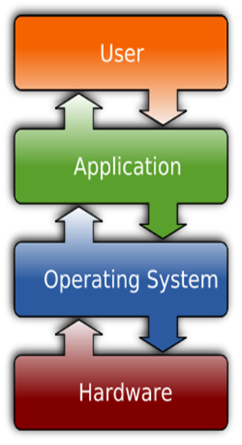
System Software Vs Application Software
System Software:
System Software refers to the operating system and all utility programs that manage computer resources at a low level.
Systems software includes compilers, loaders, linkers, and debuggers.
Application Software:
Applications software comprises programs designed for an end user, such as word processors, database systems, and spreadsheet programs.

Slide 6
Major Goals of OS
Execute user programs.
Make the computer system convenient to use.
Use the computer hardware in an efficient manner
Manages and allocate all resources
Controls the execution of user programs and operations of I/O devices

Slide 7
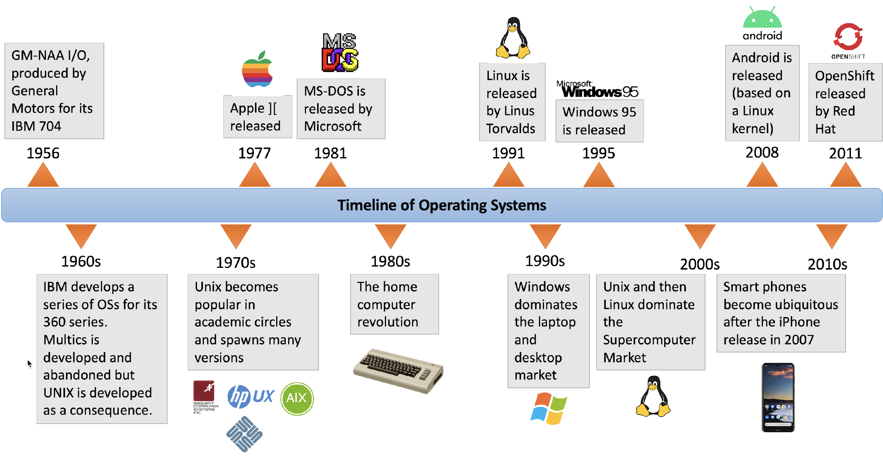
Timeline of OS

Slide 8

Timeline of OS

Slide 9
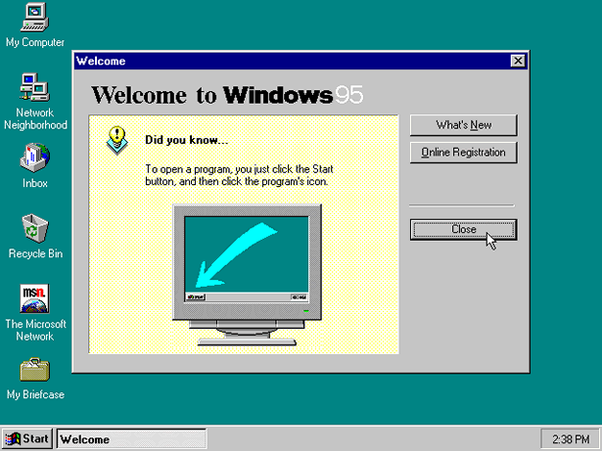
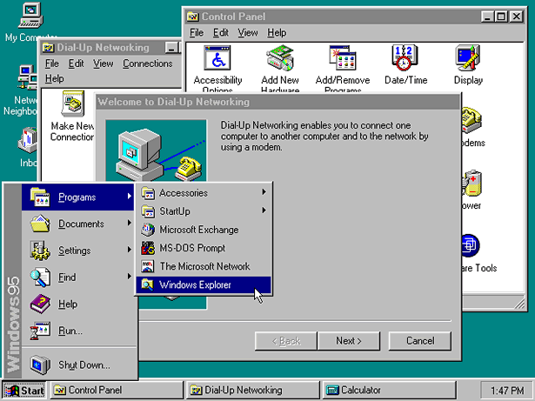
Timeline of OS

Slide 10
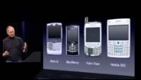
Timeline of OS
Another revolution of OS came in the mobile computing domain, when Steve Jobs introduced iPhone with iOS in 2007
The iPhone introduction video is now regarded as a classic advertise video

Slide 11
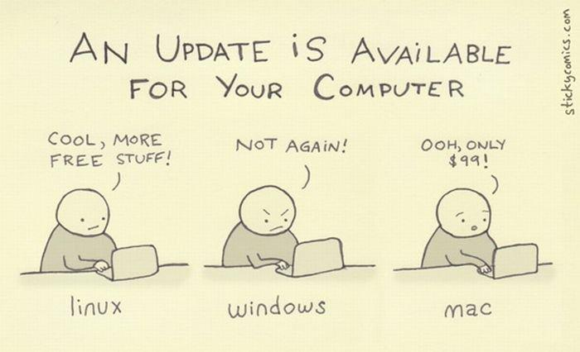

Slide 12
Kernel
The one program running at all times.
Kernel is the central module of an operating system
Part of OS that loads first, and it remains in main memory.
As small as possible
Provide all the essential services required by other parts of the operating system and applications.
Kernel code is usually loaded into a protected area of memory to prevent it from being overwritten.

Slide 13
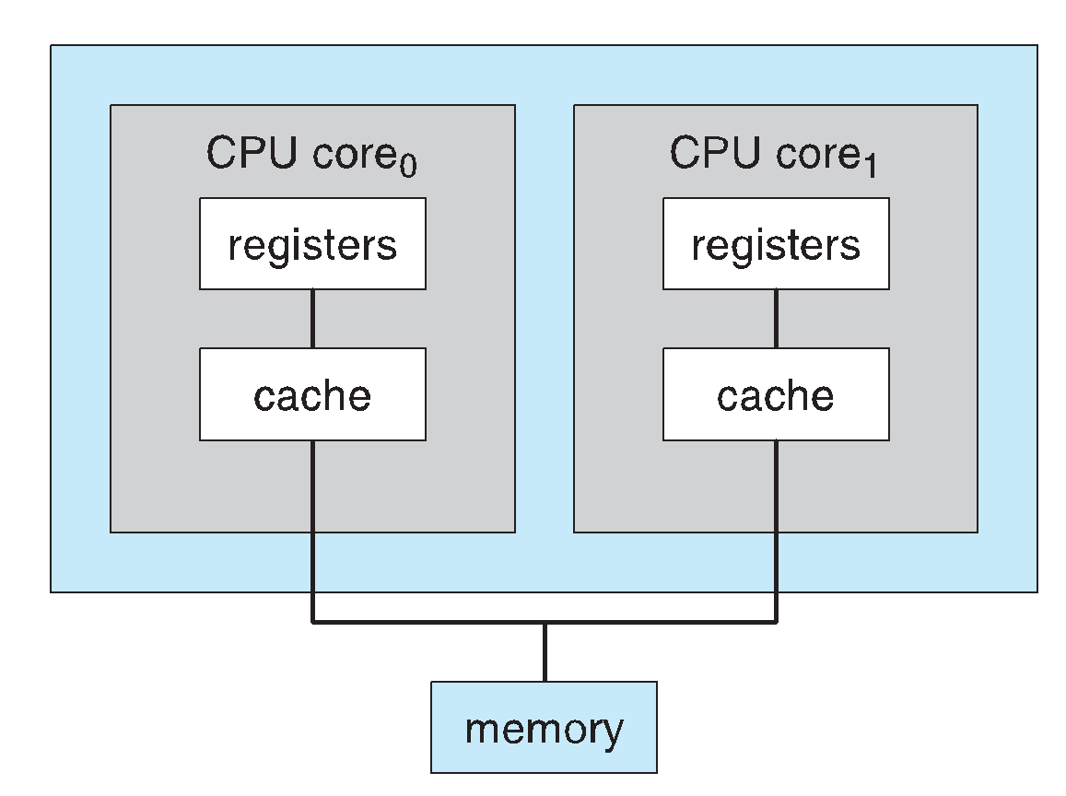
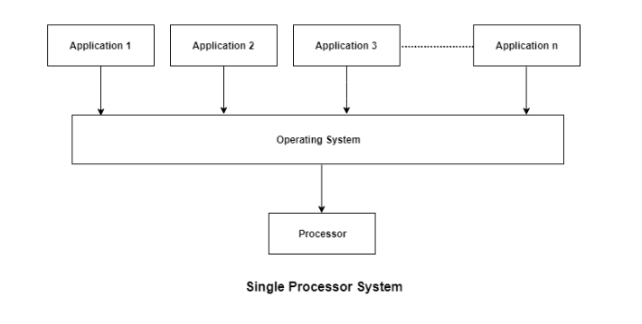
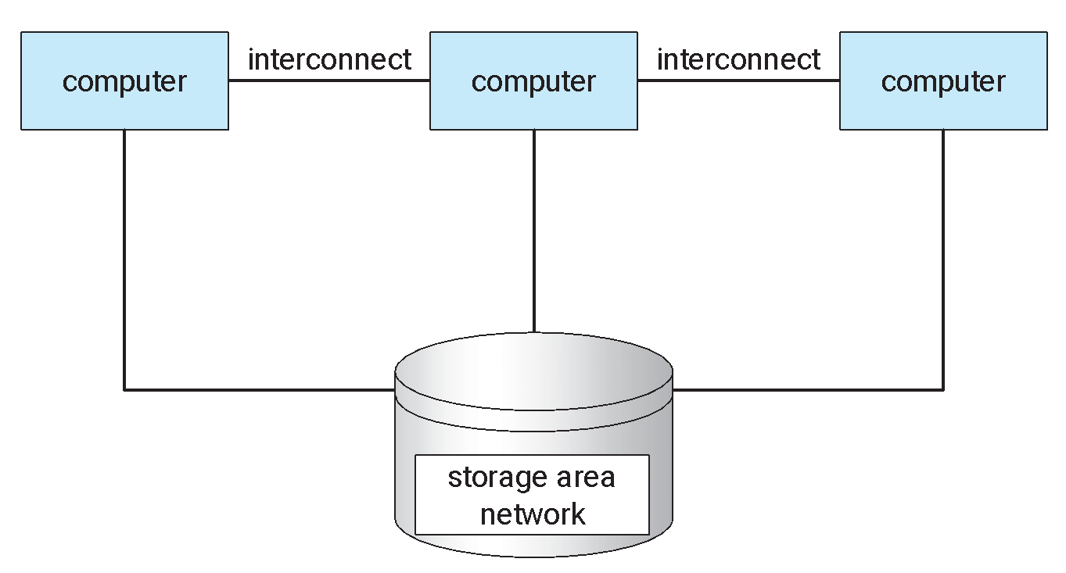
System Architecture
Single-Processor Systems
Multiprocessor Systems
Clustered Systems

Slide 14
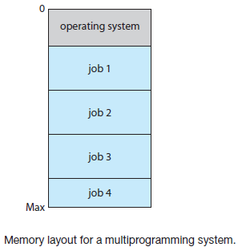
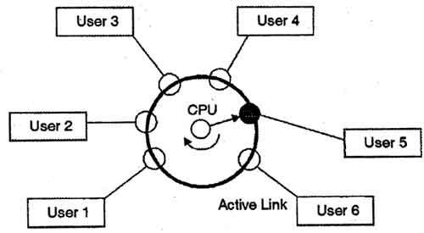
Operating System Architecture
Multiprogramming
Job Scheduling
CPU Scheduling
Time Sharing System

Slide 15
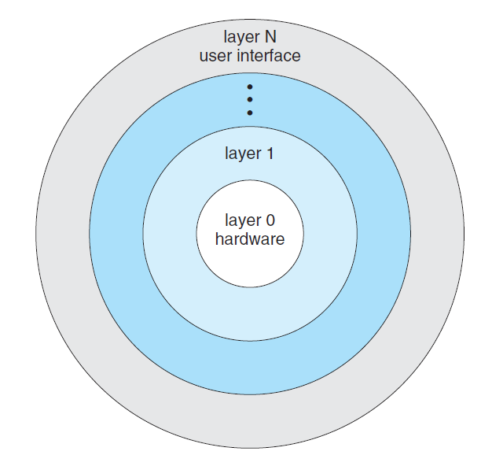
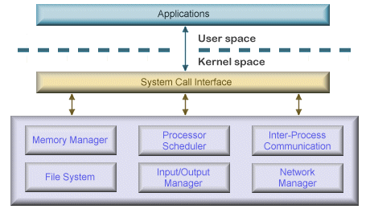
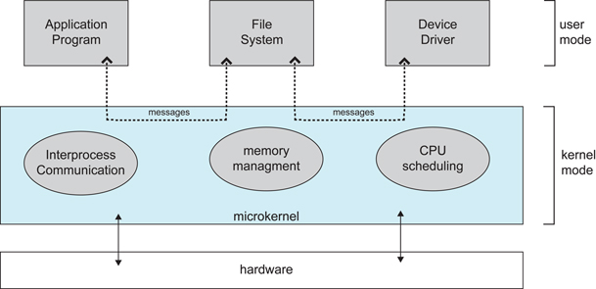
Operating System Structure
Simple/Monolithic structure
Layered structure
Microkernel structure

Slide 16
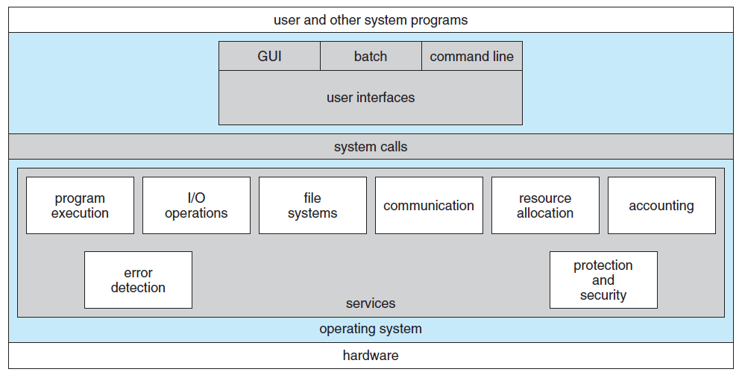
Operating System Services
OS provides an environment for the execution of programs.
Specific services provided, differ from one operating system to another, but there are some common classes
Services are provided for the convenience of the programmer

